Slide 1
AMAZON SALES ANALYSIS
BY SANTHOSHKUMAR

Slide 2
Objective
Analyze Amazon sales data to understand trends, identify key metrics, and uncover relationships between attributes.
Key Components:
Sales trends over time
Product performance
Regional sales analysis
Customer insights

Slide 3
KPI
$137m+ Total Revenue Overall income generated from the sale of various products and services on the Amazon platform. This includes the sales of physical goods and digital products
$44m+ Total Profit Net earnings after all expenses have been deducted from the total revenue. This includes the costs associated with manufacturing, purchasing, etc.
$440m+ Average Profit/Order represents the average amount of profit earned from each customer order after all costs and expenses have been accounted for.
510K+ Units Sold Provides insight that indicates how many units of each product have been purchased by customers. It evaluates the popularity of products and sales trends
10+ Products Denotes the specific nature or genre of the product, such as Baby Food, Cereal, Office Supplies, Fruits, Vegetable, Household, or Clothes, etc.
100 Total Orders Insight into sales activity helps assess customer engagement, track sales trends, and evaluate marketing and sales strategies.

Slide 4
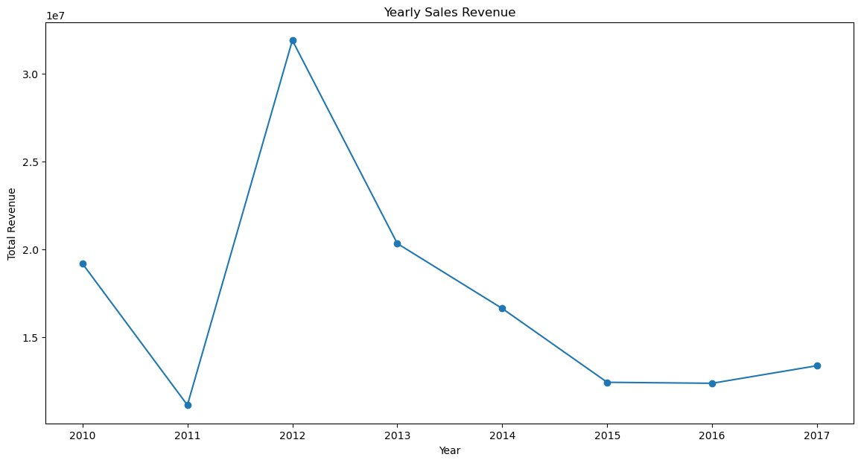
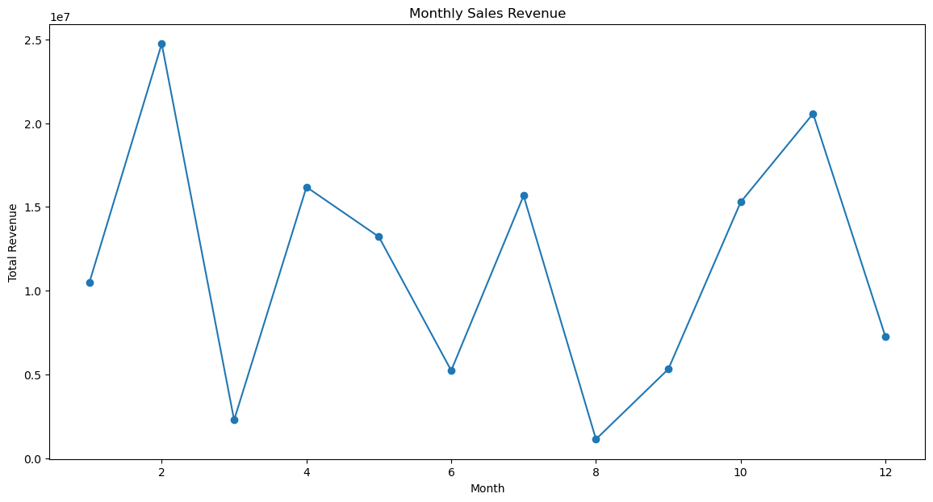
Sales Trends Over Time
Peak Year: Highest sales in 2012; declining trend observed in later years.
Top Months: February and November show the highest revenue; August and March are the lowest.
Actionable Insight: Leverage strong months and address the declining trend post-2012 for improved revenue.

Slide 5
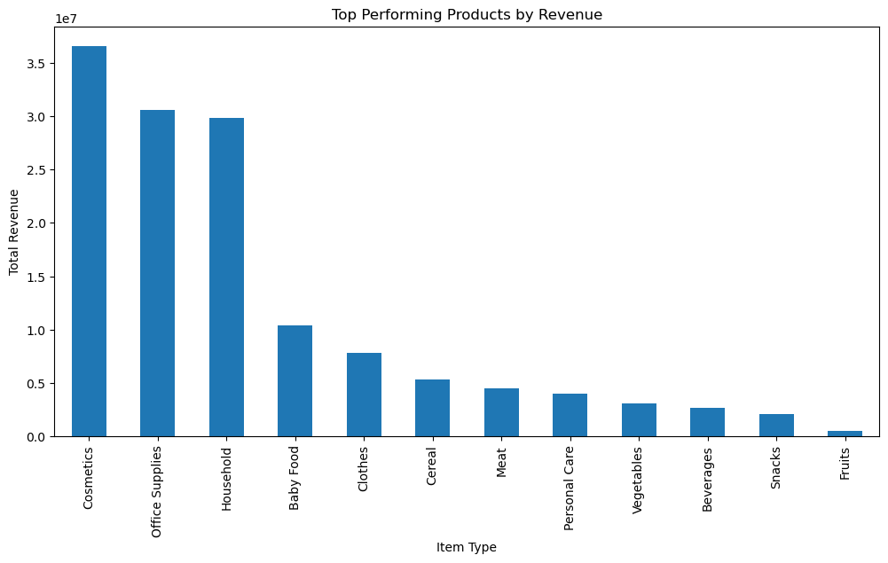
Product Performance Analysis
Top Profit Item: Cosmetics lead with the highest profit, significantly outpacing other categories.
Moderate Profit: Household items and office supplies follow, with notable contributions but less than cosmetics
Lowest Profit: Items like fruits and snacks contribute the least to total profit, indicating potential areas for focus or improvement.

Slide 6
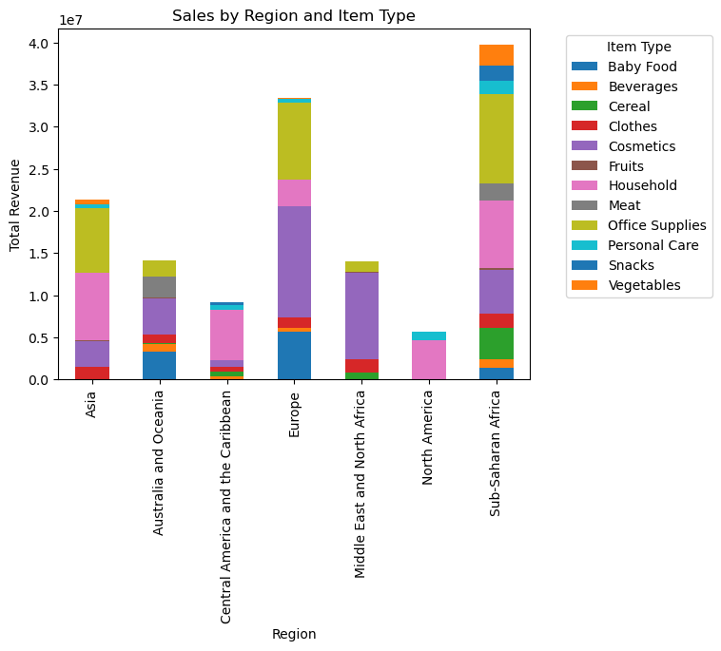
Product Performance By Region
Highest Profit Regions:
Europe: Dominates with high profits in Cosmetics and Office Supplies.
North America: Shows strong performance in Household items and Personal Care.
Top Item Types by Region:
Asia: Highest profit from Household and Office Supplies.
Australia and Oceania: Significant profit from Cosmetics and Baby Food.
Sub-Saharan Africa: Leads with profits in Office Supplies and Household items
Lowest Profit Categories:
Asia: Fruits and Personal Care have the lowest profits.
Australia and Oceania: Fruits and Cereal show lower profit margins

Slide 7
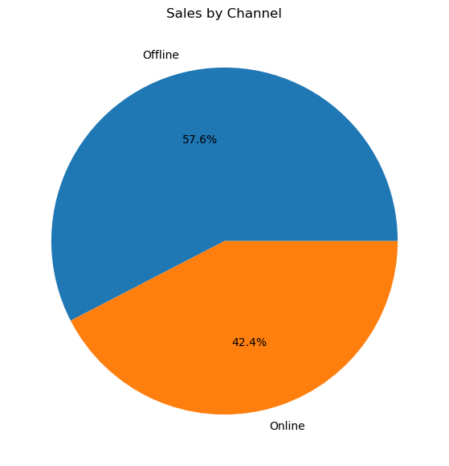
Sales By Channel
Offline channels lead in sales volume, capturing a majority of the revenue, while online channels contribute a smaller but still significant portion.

Slide 8
END

Slide 9
Heart Disease Diagnostic Analysis

Slide 10
Objective
To analyze heart disease diagnostic data to uncover trends, patterns, and relationships.

Slide 11
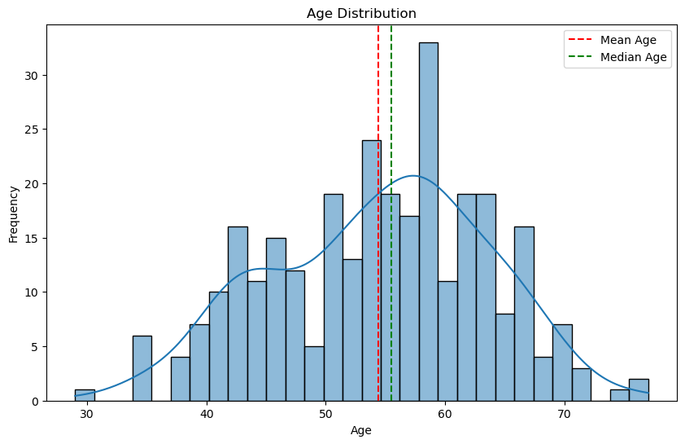
Age Distribution with Mean and Median Lines
Mean Age: 54.42
Median Age: 55.50
This indicates that the average age of individuals in the dataset is 54.42 years, while the median age, which represents the middle value when ages are sorted, is 55.50 years.

Slide 12
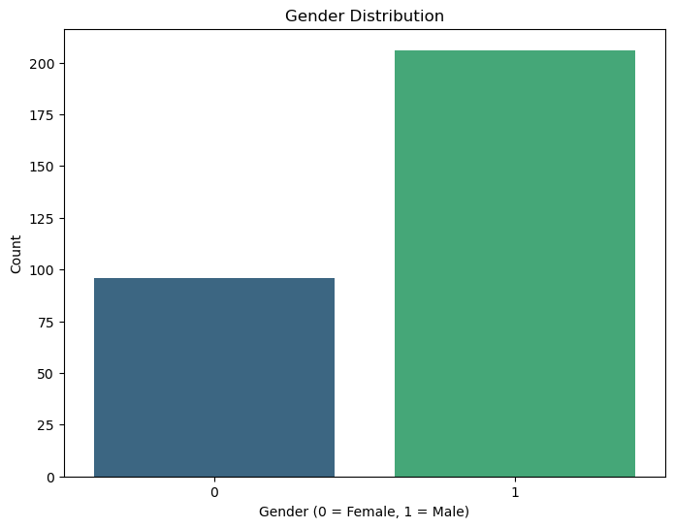
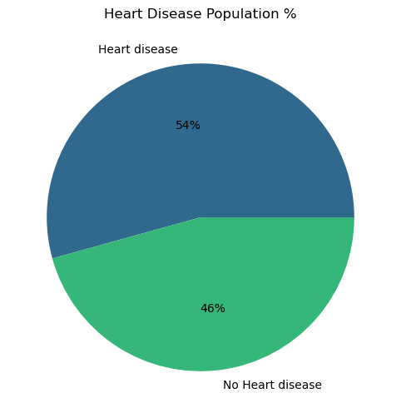
Gender Distribution
Heart Disease Diagnosis Distribution (Pie Chart)

Slide 13
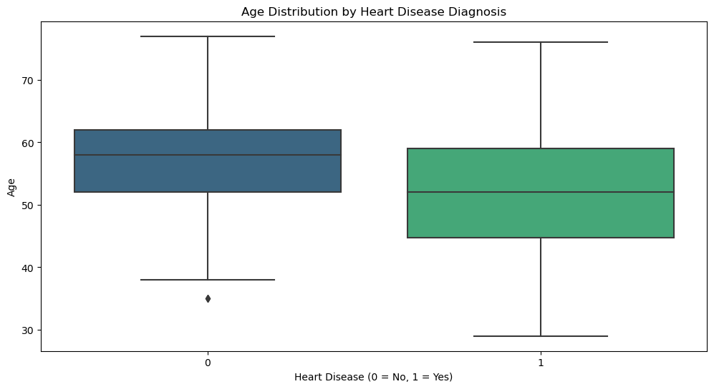
Age Distribution by Diagnosis (Boxplot)
Age and Heart Disease: The data suggests that heart disease is more common in a younger demographic compared to those without heart disease.
Healthcare Focus: This information can guide targeted health interventions and screenings for younger populations who may be at risk.

Slide 14
END

